Slide 1
Warm up
Find:
A pair of numbers that add to 9 and multiply to 20
A pair of numbers that add to negative 4 and multiply to 4
A pair of numbers that add to zero and multiply to 16
Bonus: A pair of numbers that add to zero and multiply to 5

Slide 2
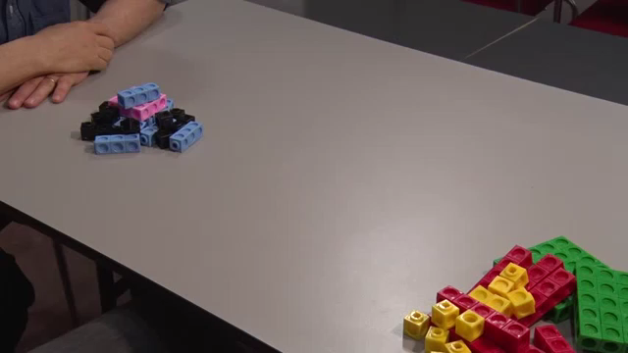
24
7
30
Date
Factorising
EQ – Can you factorise quadratic expressions graphically?
In the last lesson we looked at factorising using products and sums, lets try a hands on approach

Slide 3



24
7
30
Date
Factorising
EQ – Can you factorise quadratic expressions graphically?
$$x^{2}+5x+6$$

Slide 4




24
7
30
Date
Factorising
EQ – Can you factorise quadratic expressions graphically?
$$x^{2}+5x+6$$
$$x + 2$$
$$x + 3$$

Slide 5

Do you understand? Fists of Five
Notes:
Check for Understanding

Slide 6






Now your turn
Have a go at the following
$$x^{2}+4x+3$$
$$x^{2}+9x+20$$
$$x^{2}+6x+9$$
$$x^{2}+8x+15$$
$$x^{2}+3x+2$$
$$x^{2}+6x+8$$

Slide 7
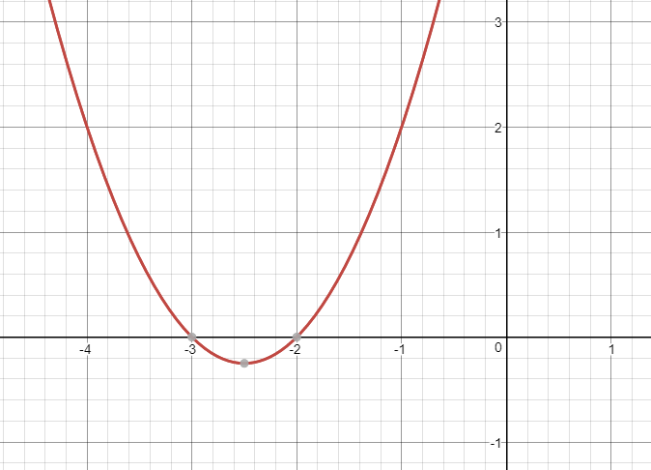
Why do we do these? A look ahead
$$x^{2}+5x+6=(x+2)(x+3)$$
Being able to factorise can tell us the points a graph will cross the x axis. We can use this to solve all kinds of problems.
Possible uses – investment bankers calculating if something will make money, missile targeting for the defence force, structural engineers designing a bridge, mobile phone designers calculating electrical resistance, designing a satellite tower, opticians looking at lenses, designing mirror arrangements for a solar power farm…

